Slide 1
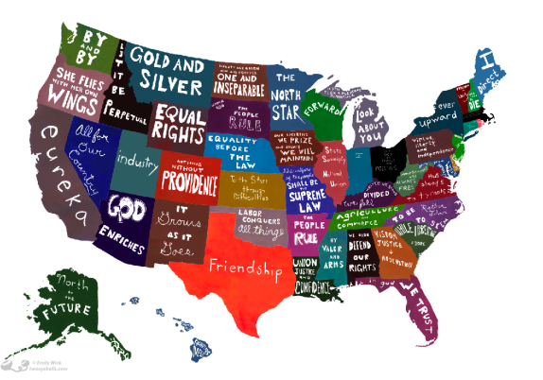
Significant Presidencies in the United States Expansion of the Federal Government
Alexa, Shane, Dara, Paige, and Ian

Slide 2
- “Honest Abe”
Republican

Slide 3
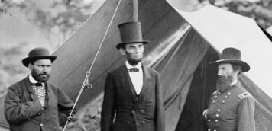
AP US Themes
American Diversity
Reform
Slavery
-Used Wartime Powers for the Emancipation Proclamation
- He also created the first ever conscription for the army
- Created the first national uniform currency
- Internal improvements, aiding railroads with land and loans
All can be seen through Lincoln’s actions during the Civil War.
Notes:
The Civil War was originally about the Federal control vs. state control; in 1860 the new republican administration was leaning towards Abolition, while the southern states wanted to keep their “peculiar institution”
After the Civil War, there was no going back from these Federal Expansions. The conquered South had to be fixed with government bureaucracy, veterans pension programs had to be created to take care of soldiers, and many new departments were created:
Rail roads allowed for the West to be settled, The Department of Agriculture was organized and Lincoln signed the Homestead Act
To deal with all the Civil War veterans bureaus were created to manage vetran’s affairs and pension programs

Slide 4
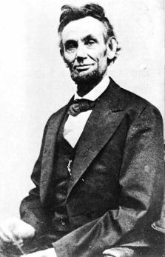
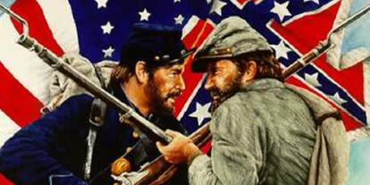
Historiographical Perspectives
Loved because of his rags to riches story
Took control as President by using Wartime Powers
‘Divine Providence’- felt close to God in times of trouble
Some feel that Lincoln's views at this time were only politically motivated, and they focused on ending the war and preserving the Union

Slide 5
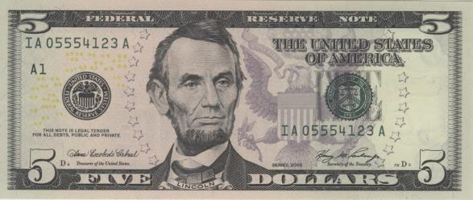
Why We Chose Honest Abe
Times of crisis usually lead to a growth in government, and this is best illustrated by the Civil War. Abraham Lincoln demonstrated his power as one of the best presidents in US history by expanding the federal government in order to preserve the Union.
Keeping a nation under control
Combated the national emergency

Slide 6
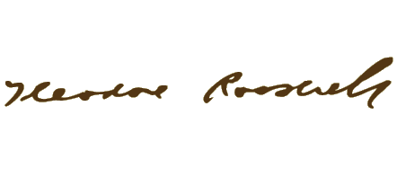
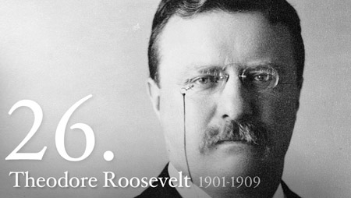
- “TR”
Republican

Slide 7
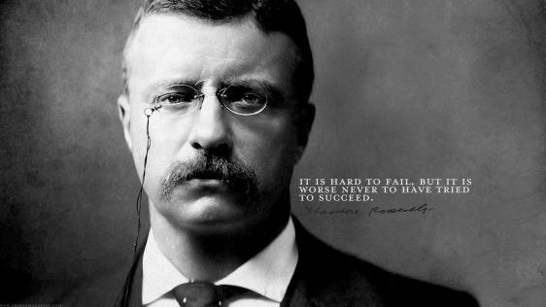
AP US Themes:
Reform- Elkins Act of 1903, civil service systems
Politics & Citizenship- The Great Regulator, Square Deal
Environment- Conservationism.. Really wanted to preserve wildlife, including 5 national parks
Notes:
Theodore Roosevelt worked to ensure a hiring system for America's government workers based on fairness and equal access and protection for all—making him the undisputed father of today's Federal Service. he Roosevelt Administration was a time of great expansion of the Federal Government, including the formation of new Departments of Commerce and Labor
Great regulator- One of Roosevelt's central beliefs was that the government had the right to regulate big business to protect the welfare of society. However, this idea was relatively untested. Although Congress had passed the Sherman Antitrust Act in 1890, former Presidents had only used it sparingly.
Square deal- The Square Deal worked to balance competing interests to create a fair deal for all sides: labor and management, consumer and business, developer and conservationist.

Slide 8
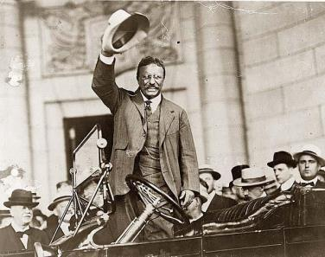
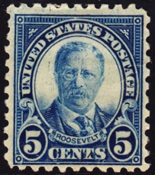
Historiographical Perspectives
Historian John Blum: great at handling the press, effectively took control
Some prefer his foreign policy over his domestic agenda
Not only a great President, but a great American
Believed in the right of the people to rule- used media
* There is no periodization for this time.
Notes:
He understood that his forceful personality, his rambunctious family, and his many opinions made good copy for the press. He also knew that the media was a good way for him to reach out to the people, bypassing political parties and political machines. He used the media as a "bully pulpit" to influence public opinion.

Slide 9
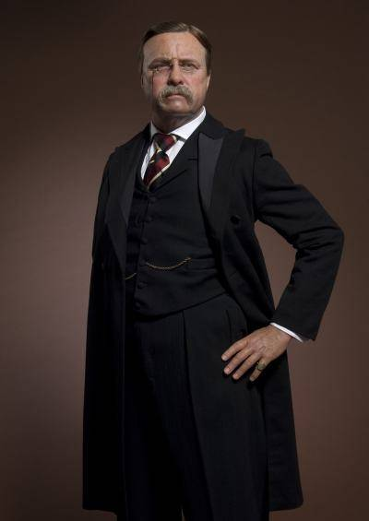
Why We Chose Teddy
Worked to ensure that the government helped improve American lives
Pushed hard to preserve our environment
Insisted on reform to fend off socialism
Understood compromises in order to get his ideas through

Slide 10
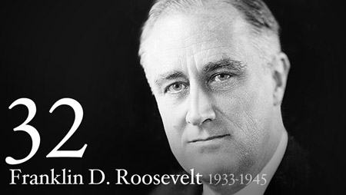
- “FDR”
Democrat

Slide 11
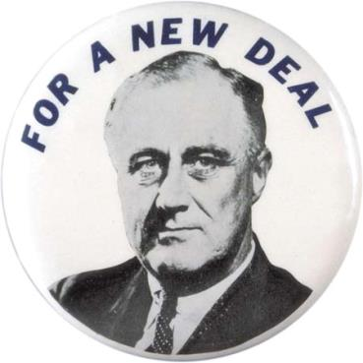
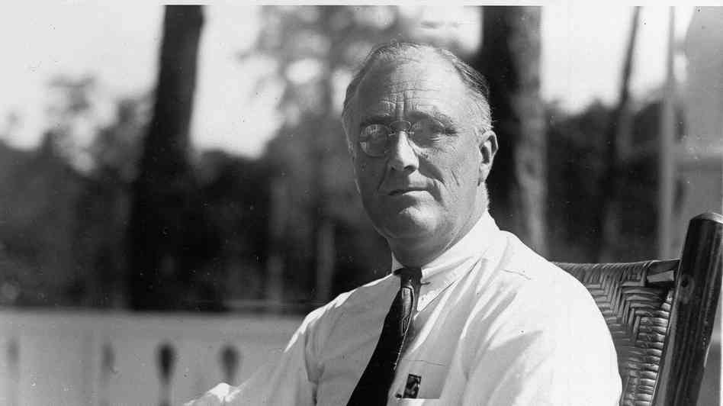
AP US Themes
Reform- The New Deal, Second New Deal
National Bank Holiday, Social Security, FDIC, ending the gold standard, AAA, TVA
“Prime the pump”
War & Diplomacy- World War II
Notes:
The New Deal sought to insure that the economic, social, and political benefits of American capitalism were distributed more equally among America's large and diverse populace.
Once in office, FDR set to work immediately. His "New Deal," it turned out, involved regulation and reform of the banking system, massive government spending to "prime the pump" by restarting the economy and putting people back to work, and the creation of a social services network to support those who had fallen on hard times.
Second New Deal: Although FDR had forged a broad, progressive coalition during his 1932 campaign, by 1935 it seemed to be fraying at the seams. The most progressive members (like the outspoken Senator Huey Long) argued that the New Deal didn't go far enough, while wealthier business interests were opposed to what they saw as a government takeover of the economy. The lowest point came in May of 1935, when the Supreme Court unanimously struck down the National Industrial Recovery Act, a key piece of New Deal legislation

Slide 12
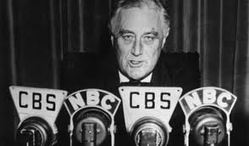
Historiographical Perspective
"Father Figure" for many Americans, partly because of his length in office, and partly for his familiar fire side chats
Thought New Deal harmed those who were poor
Roosevelt tried with all of his vigor to repair America's economy
Appreciate that his New Deal was the first direct investment in the American people

Slide 13
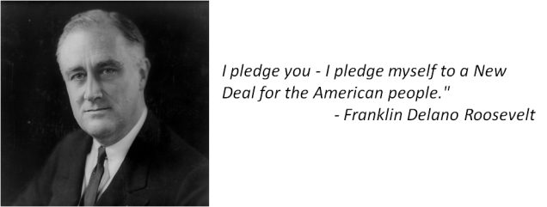
Why We Chose FDR
Under FDR, the American federal government assumed new and powerful roles in the nation's economy, in its corporate life, and in the health, welfare, and well-being of its citizens.
The New Deal sought to insure that the economic, social, and political benefits of American capitalism were distributed more equally among America's large and diverse populace.

Slide 14
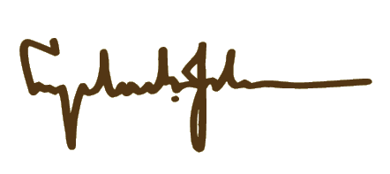
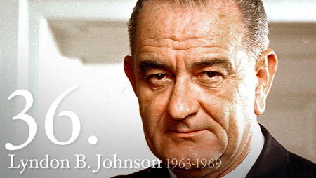
- “LBJ”
Democrat
Notes:
He provided the federal government with a vast expansion in the role of the national government in domestic affairs.

Slide 15
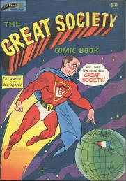
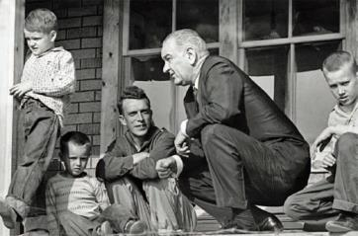
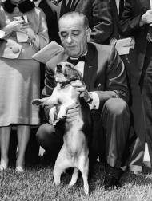
AP US Themes:
Reform- The Great Society as the basis
Politics & Citizenship- Immigration and Nationality Act of 1965, Civil Rights, War on Poverty
Environment- Rural development, environment as a whole
Notes:
He called on the nation to move not only toward "the rich society and the powerful society, but upward to the Great Society," which he defined as one that would "end poverty and racial injustice.” The most dramatic parts of his program concerned bringing aid to underprivileged Americans, regulating natural resources, and protecting American consumers.
I & N Act- Immigration changed America's demographics, opening the doors to immigrants from Asia, Africa, and the Middle East. Made it easier to come into the US
Civil rights act of 1964- outlawed major forms of discrimination
War on Poverty- Food stamp act, community action programs
Environment- over 10 new acts to improve it. Wilderness act, endangered species act

Slide 16
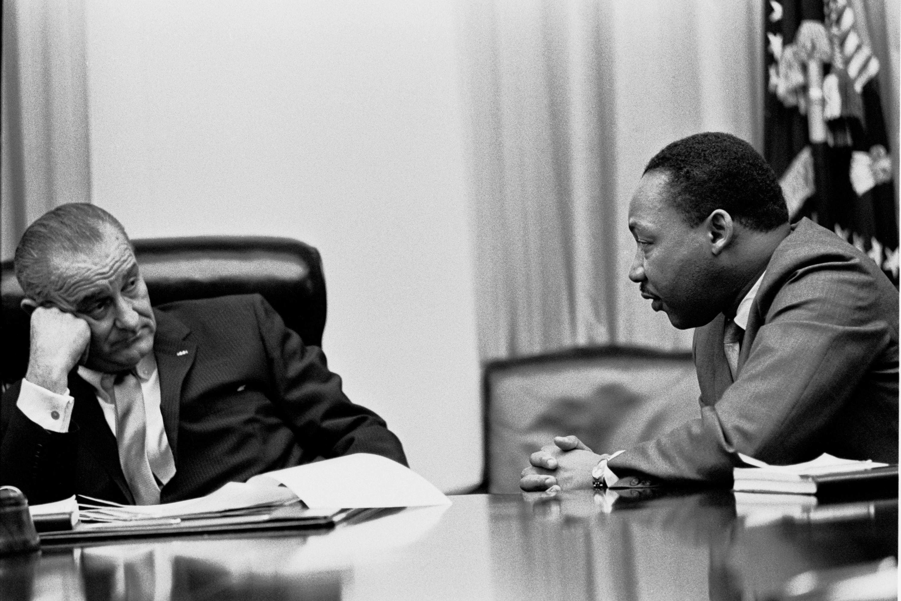
Historiographical Perspective
Very successful, but also many failures
Well-liked by the public, winning the popular vote in 1964
His Great Society mainly rivaled FDR’s New Deal
Worked for the good of the country
Going into the Vietnam War was a bad idea
Felt he had to commit US forces
Under pressure
*There is no periodization for this time.
Notes:
Parts of his Great Society still remain controversial, including the War on Poverty. Economist Thomas Sowell argues that the Great Society only contributed to the destruction of African American Families. Spent lots of money in helping these people

Slide 17
Why is LBJ in our five?
Strongest advocate for civil rights since Abe Lincoln
Brought reform to a whole new level
Tax cuts- great prosperity in the post war years
Higher Education Act of 1965
Medicare/Medicaid
National endowments for arts & humanities
Public broadcasting
Child Safety Act of 1966
Notes:
The only issue is that he was side tracked by Vietnam.. Without that he could be considered one of the greatest presidents of all time. He sincerely tried to help the people of the country. This is true expansion. There is no denying it that Johnson helped fuel our country and get us back in track after Kennedy’s assassination.

Slide 18
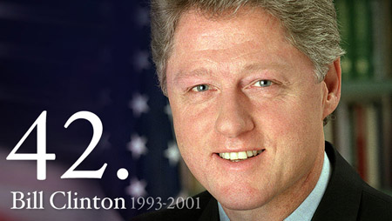
- “Bill”
Democrat

Slide 19
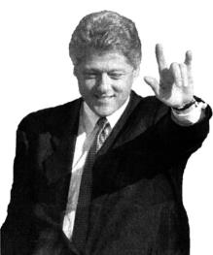
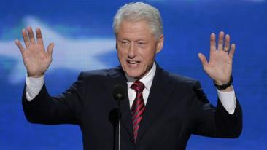
AP US Themes
Economic Transformations
Reform
Bill Clinton began his transition into the presidency promising to focus "like a laser beam" on the economic needs of the nation: unemployment, the runaway deficit, the health care crisis, and welfare reform. On all fronts but one, health care reform, he succeeded significantly but not completely.
Notes:
Surpluses amounting to $1.5 trillion were then projected for the first decade of the 21st century. Equally important were the pace of economic growth and low inflation. Combined with historically low interest and unemployment rates, these factors positioned the American economy as the world's strongest and most robust.
North American Free Trade Agreement (NAFTA), which cleared Congress in 1993
the President blocked Republican attempts to bar public education to children of illegal immigrants.
Along with the political scandals that plagued his presidency, Clinton failed to realize a major goal of his administration: affordable health care insurance for every American.
“Don’t ask, don’t tell”

Slide 20
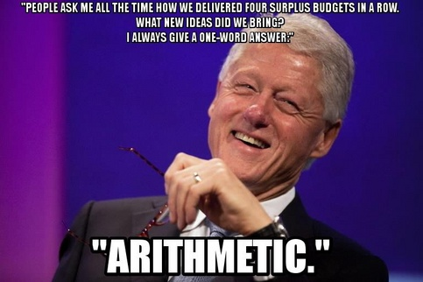
Historiographical Perspectives
Helped America get out of debt
“I tell you, it's the most successful presidency since FDR, maybe LBJ if he hadn't had Vietnam, but if you look at what the man set out to do and what he accomplished, stack him up against anybody...” – Paul Begala
His downfall- White Water and Paula Jones & Monica Lewinsky Scandal
Brings many negative views
Notes:
Throughout his time in office, Clinton was regularly besieged by political opponents, especially those on the far right-wing of the Republican Party. A combination of such attacks, and the Clintons' own missteps, made the President and First Lady the subjects of numerous special investigations.

Slide 21
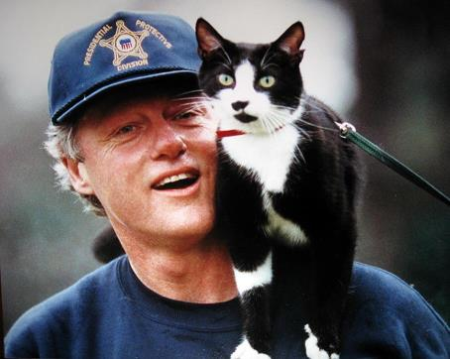
Why We Chose ‘Clinton’
Clinton signed a bill that gave him the power of the “line-item veto”. This allowed him to veto specific items in spending and tax bills without vetoing the entire measure.
Expanded government to help build economic growth.
It’s Bill Clinton…!

